Slide 1


Slide 2
[01]
Introduction to Real World Evidence

Slide 3
[01.1]
Clinical Research

Slide 4
[01] Introduction to Real World Data
Evidence Based Medicine
Research
Creative and systematic work undertaken to increase the stock of knowledge.
Clinical Research
Clinical research encompasses various research methodologies used to generate valid evidence for evaluating treatment efficacy and making informed decisions.
Evidence Based Medicine
The clinical practice where interventions and procedures are based on pure medical evidence extracted from hospital systems.

Slide 5
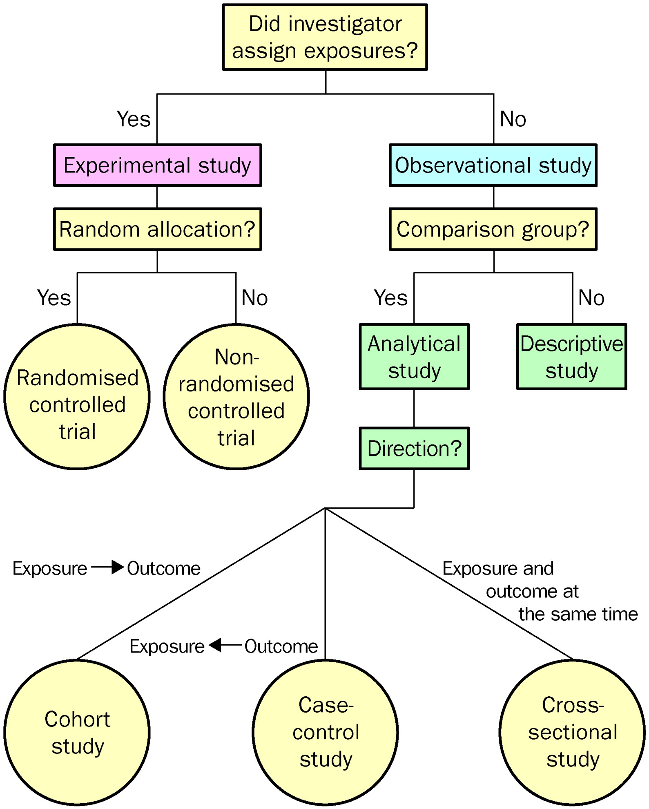
[01] Introduction to Real World Data
Research methodologies
The evidence from experimental studies, is generally considered stronger due to the use of randomization, which effectively minimizes confounding factors, resulting in more valid and reliable conclusions. In contrast, observational studies are primarily suitable for generating hypotheses rather than conclusively evaluating a treatment's efficacy.
Grimes D, Schulz K. An overview of clinical research: the lay of the land. The Lancet, 359, 57-61

Slide 6
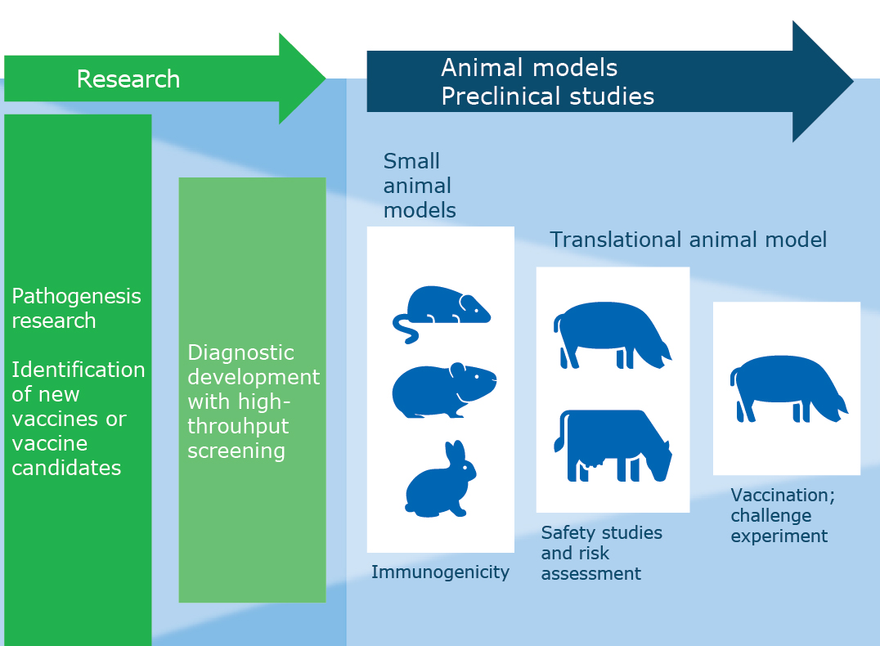
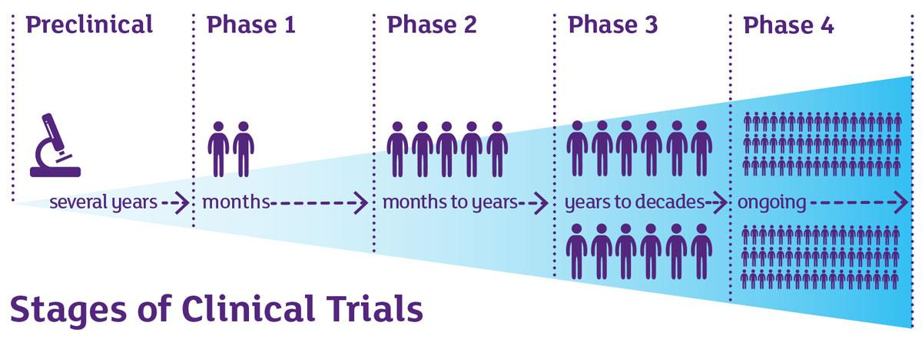
[01] Introduction to Real World Data
Evidence generation pathway, from hypothesis to clinical practice
Clinical phase
Safety and Dosage
Effectiveness
Confirmatory Efficacy
Post-Market Survillence
Controlled environment → Reduce confusion factors
Real World

Slide 7
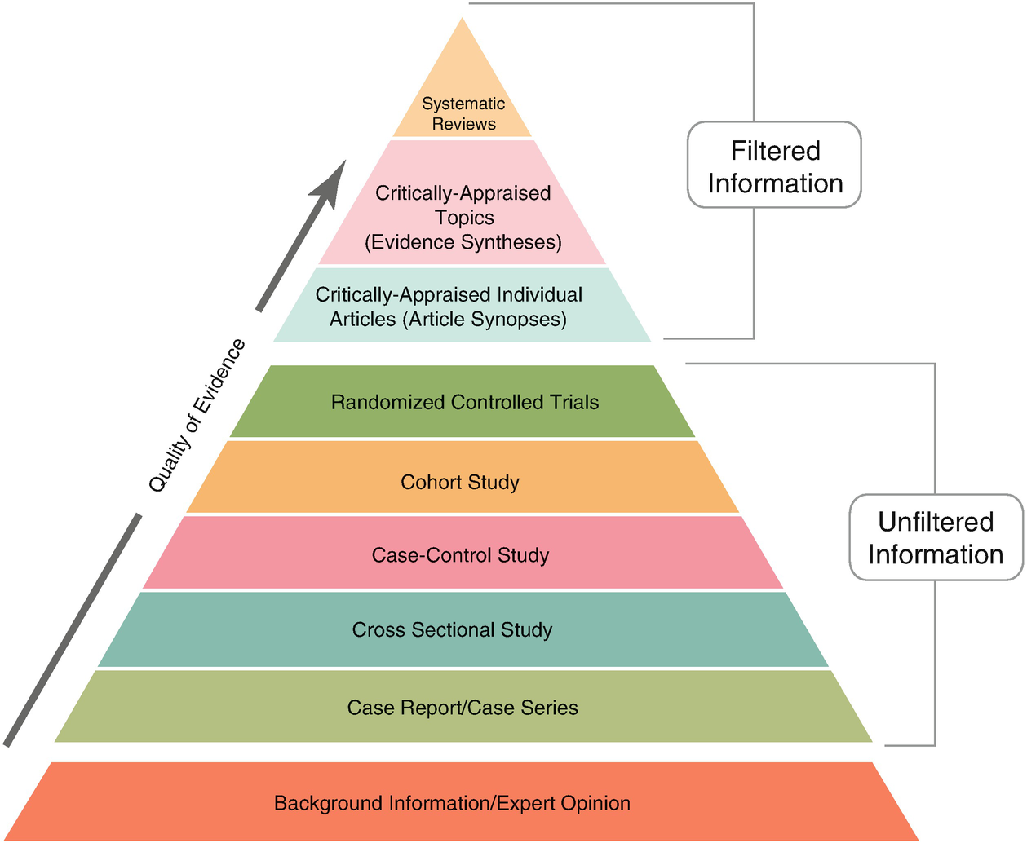
[01] Introduction to Real World Data
Hierarchy of evidence
Highest Quality
The hierarchy of evidence ranks research methodologies by the strength and reliability of their conclusions.
Not all studies provide equally valid evidence.
It should prioritize the most robust evidence for evaluating treatment efficacy and making informed decisions.
Burns, Patricia B.; Rohrich, Rod J.; Chung, Kevin C. (July 2011). "The Levels of Evidence and Their Role in Evidence-Based Medicine". Plastic and Reconstructive Surgery. 128 (1): 305–310. doi:10.1097/PRS.0b013e318219c171. PMC 3124652. PMID 21701348.

Slide 8
[01] Introduction to Real World Data
Highest Quality
Burns, Patricia B.; Rohrich, Rod J.; Chung, Kevin C. (July 2011). "The Levels of Evidence and Their Role in Evidence-Based Medicine". Plastic and Reconstructive Surgery. 128 (1): 305–310. doi:10.1097/PRS.0b013e318219c171. PMC 3124652. PMID 21701348.

Slide 9
[01.2]
Real World Evidence (RWE)

Slide 10
[01] Introduction to Real World Data
What is Real World Evidence ?
Real-World Evidence (RWE) is clinical evidence regarding the usage, safety, and effectiveness of medical products derived from analyzing Real-World Data (RWD).
Prieto, Daniel. (July 2024). "RWE, Why do we care". Oxford University

Slide 11
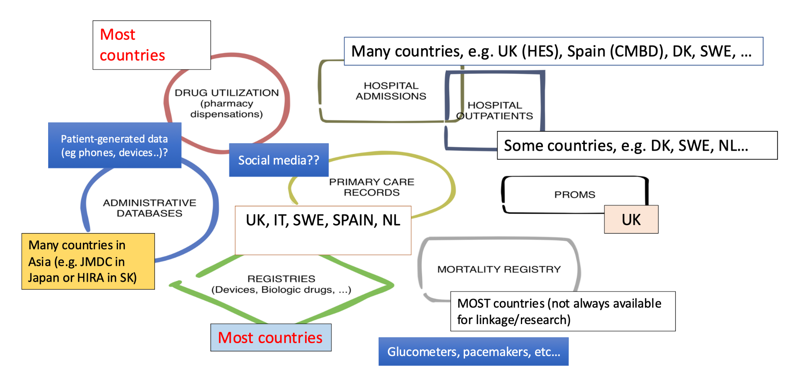
[01] Introduction to Real World Data
Where / What is the Real World Data (RWD) ?
Prieto, Daniel. (July 2024). "RWE, Why do we care". Oxford University

Slide 12
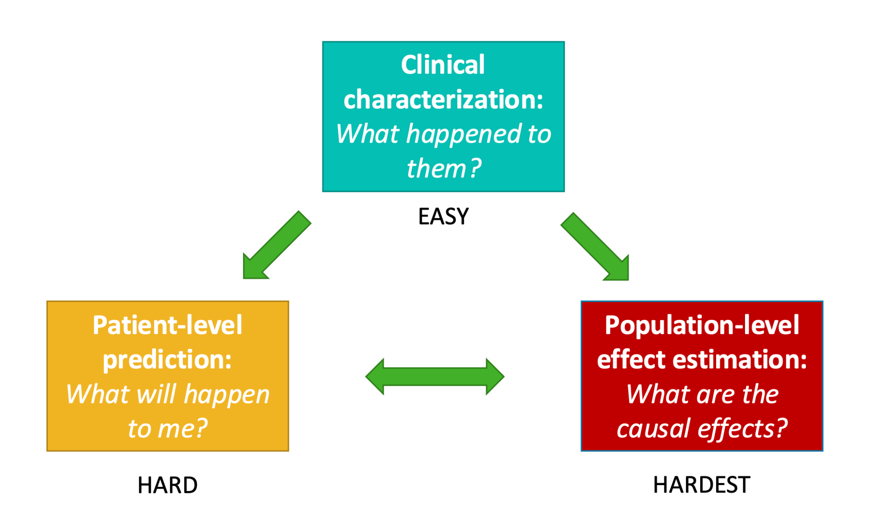
[01] Introduction to Real World Data
What evidence can we generate using RWD ?
Prieto, Daniel. (July 2024). "RWE, Why do we care". Oxford University

Slide 13
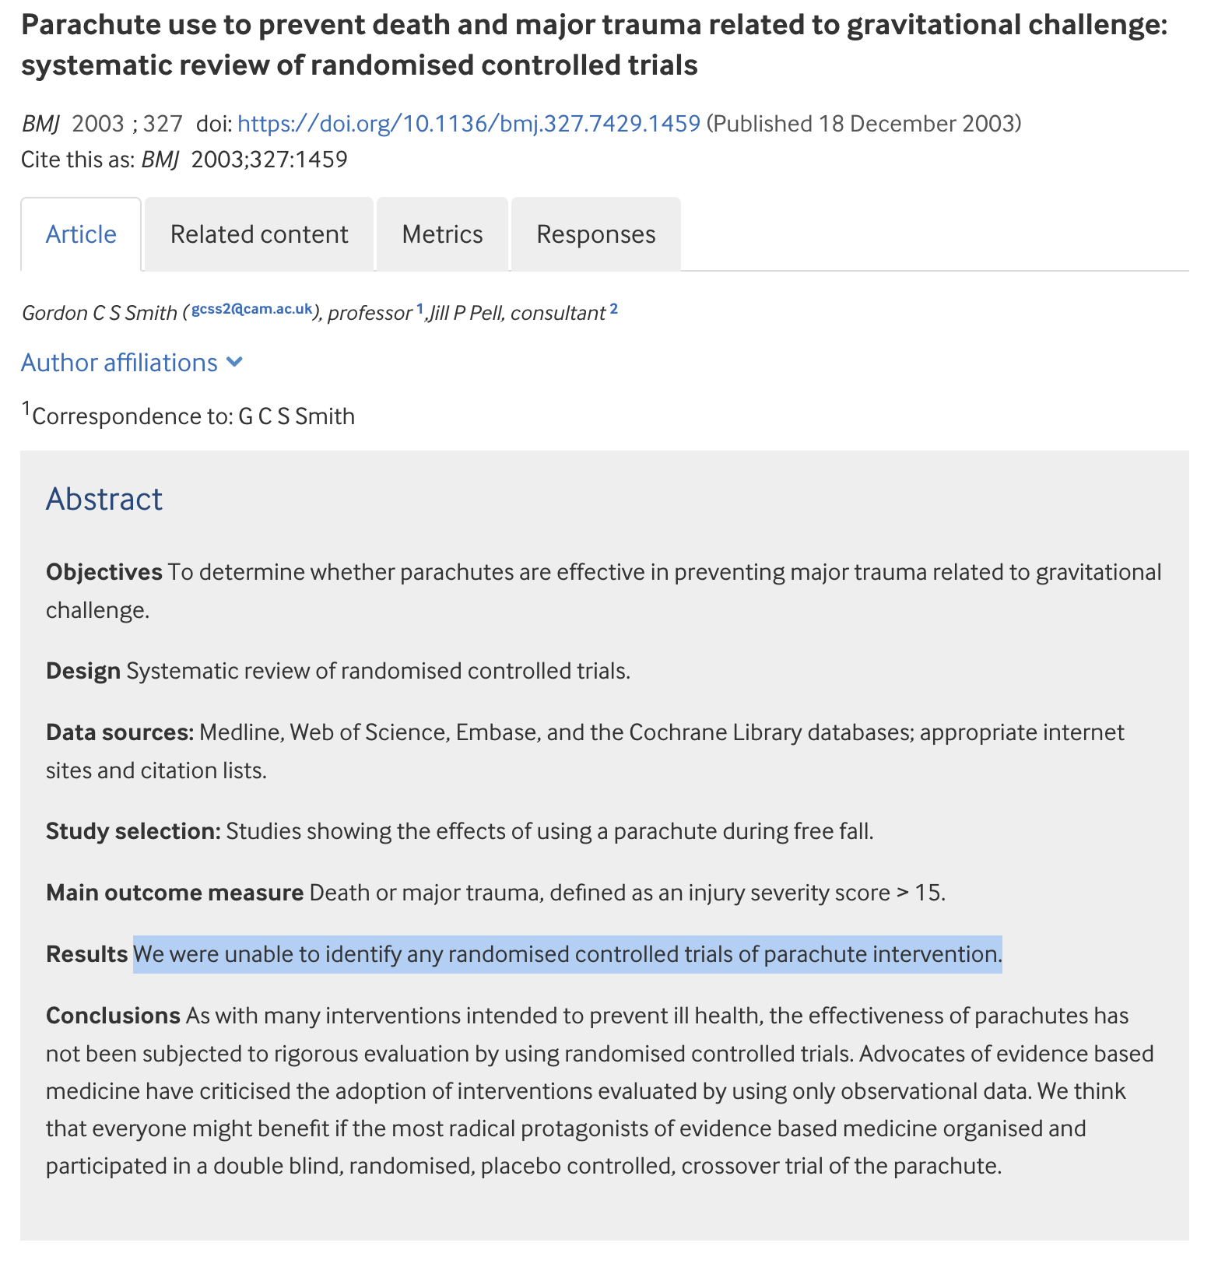
[01] Introduction to Real World Data
Why “Real World” Evidence?
To overcome research methodology limitations
RCTs are not always possible …
Rapid replication thanks to data availability
Generalizability
Efficacy vs Effectiveness
Safety
Smith G C S, Pell J P. Parachute use to prevent death and major trauma related to gravitational challenge: systematic review of randomised controlled trials BMJ 2003; 327 :1459 doi:10.1136/bmj.327.7429.1459

Slide 14
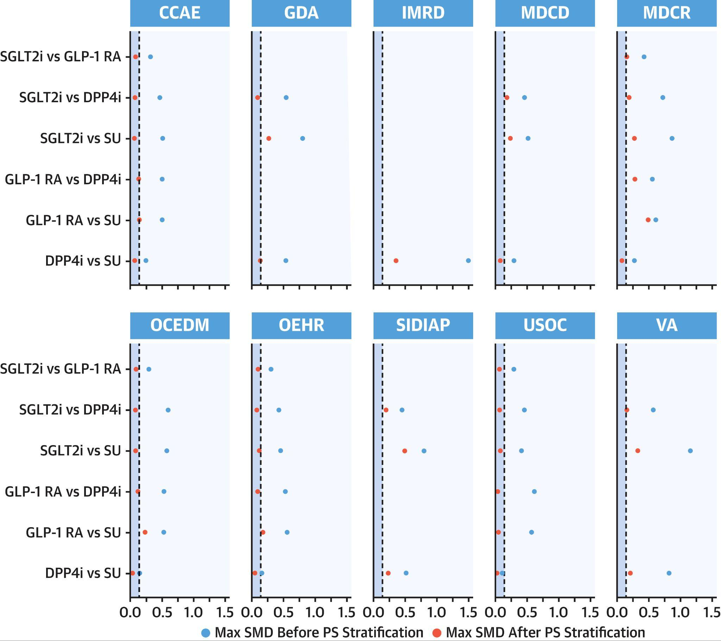
[01] Introduction to Real World Data
Why “Real World” Evidence?
To overcome research methodology limitations
RCTs are not always possible …
Rapid replication thanks to data availability
Generalizability
Efficacy vs Effectiveness
Safety
Smith G C S, Pell J P. Parachute use to prevent death and major trauma related to gravitational challenge: systematic review of randomised controlled trials BMJ 2003; 327 :1459 doi:10.1136/bmj.327.7429.1459

Slide 15
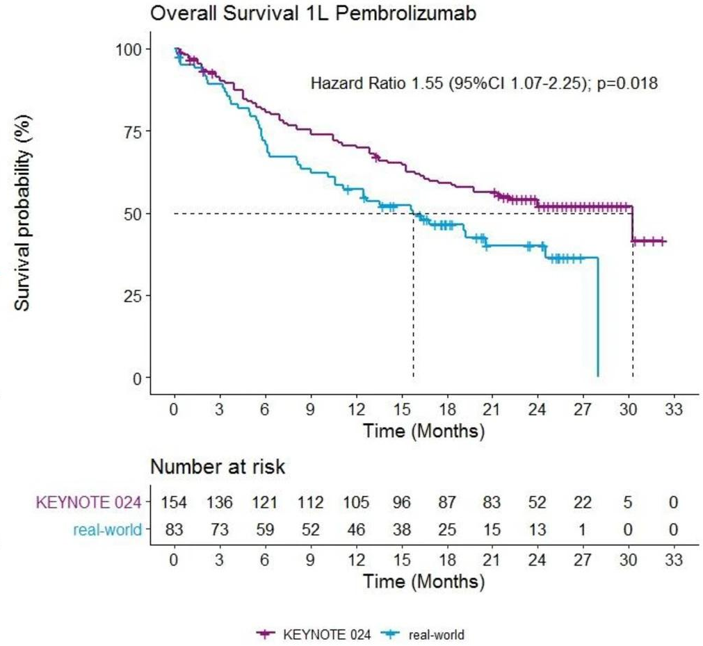
[01] Introduction to Real World Data
Why “Real World” Evidence?
To overcome research methodology limitations
RCTs are not always possible …
Rapid replication thanks to data availability
Generalizability
Efficacy (can it work?) vs Effectiveness (does it work?)
Safety
Cramer-van der Welle, C.M., Verschueren, M.V., Tonn, M. et al. Real-world outcomes versus clinical trial results of immunotherapy in stage IV non-small cell lung cancer (NSCLC) in the Netherlands. Sci Rep 11, 6306 (2021). https://doi.org/10.1038/s41598-021-85696-3

Slide 16
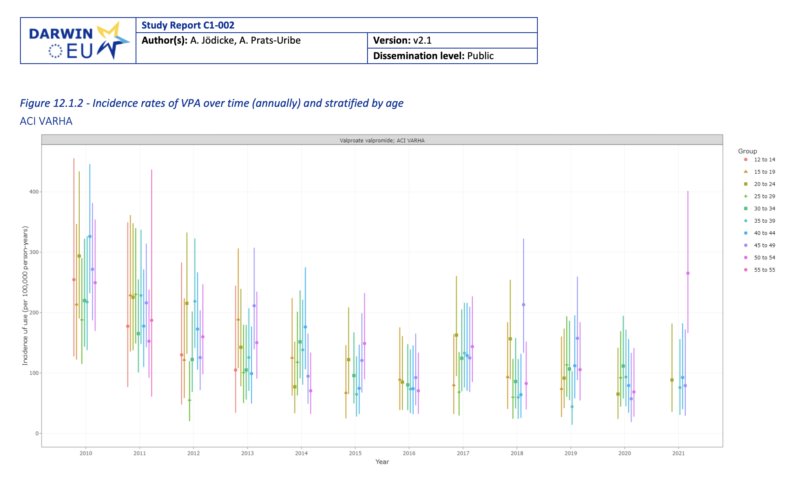
[01] Introduction to Real World Data
Why “Real World” Evidence?
To overcome research methodology limitations
RCTs are not always possible …
Rapid replication thanks to data availability
Generalizability
Efficacy vs Effectiveness
Safety
Prieto, Daniel. (July 2024). "RWE, Why do we care". Oxford University

Slide 17
[01] Introduction to Real World Data
Where in the product life cycle of a treatment is RWE useful ?
Hypothesis generation
Product Development
Vigilence
Development
Clinical testing
Post-marketing
Natural history
Descriptive epidemiology
Cluster analyses
Current care
Trial feasibility
Synthetic arm
Pragmatic trials
Trial follow-up extension
Utilisation
Post-authorization safety
Comparative effectiveness
[01]
[02]
[03]

Slide 18
[01] Introduction to Real World Data
RWE limitations - Associated biases
Selection bias of the population
Minimization: multicentric, non-prefilter cohorts
Information bias: incorrectly recorded information, which could lead us to establish erroneous conclusions. Missing information, unrecorded variables.
Minimization: quality controls, imputation
Confounding bias: a confounding variable is a risk factor for the disease under study that is associated with the exposure of interest but is not part of the causal relationship between exposure and outcome.
Minimization: matching, adjustment for variables in regression models, negative control outcomes
Indication bias: exposure to a drug is not random, so the characteristics of the exposed and unexposed are not identical.
Minimization: large-scale propensity score matching

Slide 19
[01] Introduction to Real World Data
RWE Strengths - Associated biases
Sample size – representativeness
Follow-up
Speed
Costs
Use of different epidemiological designs
Population under clinical practice conditions - "real-world data":
Population not included in clinical trials
Variety of information - N outcomes and exposures
Drug indications not studied in clinical trials
Drug interactions
Long-term pharmacovigilance: PASS studies

Slide 20
[01.3]
Real World Data

Slide 21



[01] Introduction to Real World Data
Real World Data
Clinical data collected from various sources
Electronic Health Record (EHR), Lab data, pharmacy..
Collection purpose in NOT clinical research
Data has been generated by Management / administrative / billing purposes
Real-world Evidence
◦ Generated from RWD
◦ Safety, Effectiveness, Utilization
◦ Healthcare interventions in real-world settings

Slide 22
[01] Introduction to Real World Data
Types of RWD
Patient Registries
◦ Ad-hoc manual collection of Death / Disease / Treatments
Health Claims
◦ Billing reimbursement (ICD -10 codes, RAE-CMBD)
Manual Collection
◦ Data is entered into an Electronic Case Report Form (eCRF) by site staff
Medical device data
◦ Data is sourced from Databases from a medical device

Slide 23
[01] Introduction to Real World Data
Types of RWD
Biobanks
◦ Use of historical organic data
Patient-reported outcomes
◦ Data collected by the patients
Database study
◦ Data is sourced from Databases from the daily practice

Slide 24
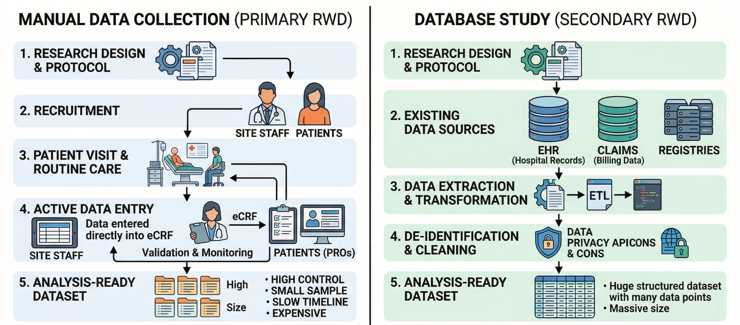

[01] Introduction to Real World Data
Grimes D, Schulz K. An overview of clinical research: the lay of the land. The Lancet, 359, 57-61

Slide 25
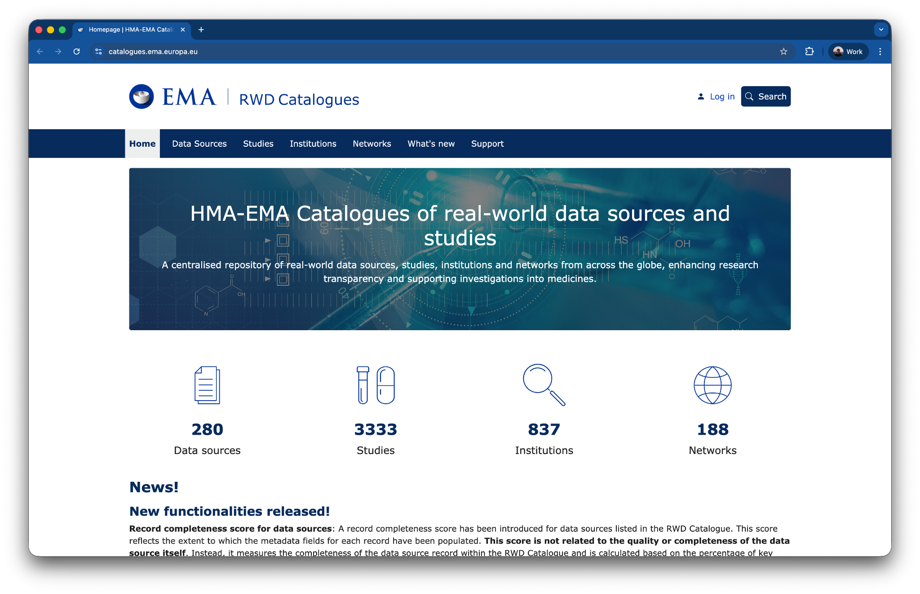
[01] Introduction to Real World Data
Ejemplos: https://catalogues.ema.europa.eu

Slide 26
[01] Introduction to Real World Data
Characteristics of RWD
Heterogeneity
◦ Variations in data format, structure, and quality
◦ Variations in data collection purpose
◦ Challenging for data integration, standardization and analysis
Temporal Longitudinality
◦ Allows for the study of treatment patterns, disease progression, and long-term outcomes.
Real-World Context
◦ Reflects the complexities and variations of
routine clinical practice
Coded nature
◦ Lookups
◦ Dictionaries (Medical, Product)
◦ Coding systems
Vast quantity
Anonymised vs Pseudo-anonymised

Slide 27
[01.4]
Legal
framework

Slide 28
[01] Introduction to Real World Data
The legal basis for RWE
The EU Foundation: GDPR Article 9(2)(j)
The "Research Exception": Provides the primary exemption to process sensitive health data without individual consent when necessary for scientific research in the public interest.
Requirement for Safeguards: The waiver of consent is conditional upon implementing "appropriate safeguards" defined by Member State law.

Slide 29
[01] Introduction to Real World Data
The legal basis for RWE
Spanish National Implementation
LOPDGDD (DA 17): The Disposición Adicional Decimoséptima is the specific Spanish legal instrument that authorizes non-consent processing for health research.
Real Decreto 957/2020: This is the current and authoritative decree governing observational studies; it has superseded the outdated Orden SAS/3470/2009.
Binding Commitment: Researchers must execute a formal, legally binding non-reidentification and confidentiality commitment to satisfy the proportionality mandate

Slide 30
[02]
Real World Data at scale

Slide 31
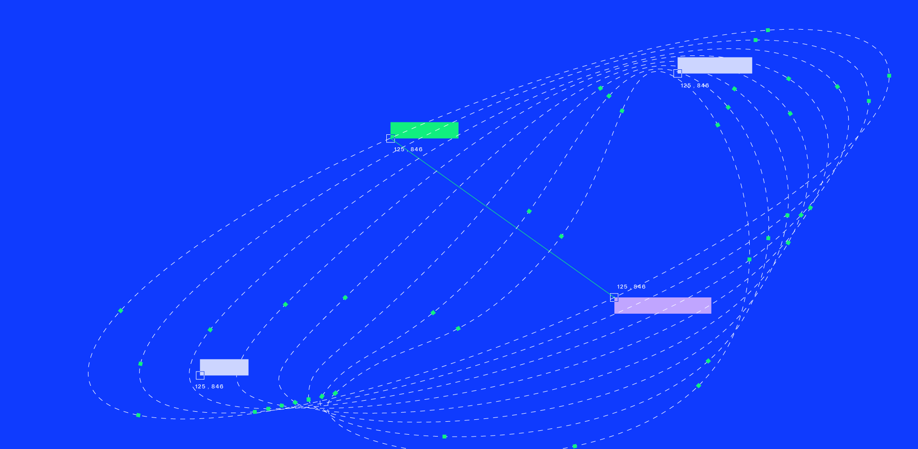

C/ de St. Antoni Maria Claret, 167, Sant Leopold Pavillion, 08025 — Barcelona
info@iomed.health
IOMED.HEALTH

